Slide 1
Web development
Presented by :
Noureddine mekada

Slide 2
Summary
Introduction to the web
How does the web works ?
What do you need to be a developer ?
What’s the role of a web developer ?

Slide 3
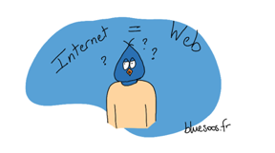
Introduction to the web
The answer is NO
The world-wide Web ( WWW ) is certainly what most people think of when they see the word internet.
But the WWW is only a subset of the internet.

Slide 4
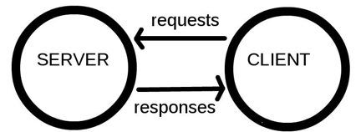
Les composants du web
Clients and servers : Computers that connect to the web are called clients and servers. Here's a simplified diagram that illustrates how they interact:

Slide 5

The other components of the Web : The client and the server aren't the only things involved. There are many other components that we will describe in the rest of this article.
Let’s draw a parallel between the web and a street. On one side of the street, there is a house that corresponds to the customer. On the other side, a store corresponding to the server, and in which you want to buy something.

Slide 6
How does the web works ?
When you type a web address into your browser (in our comparison it's like going to the store):
the browser asks the DNS for the real address of the server containing the website (you find the address of the store).
the browser sends an HTTP request to the server asking it to send a copy of the website to the customer (you go to the store and place an order). This message, and other data sent between the client and the server, is exchanged over the internet connection using TCP / IP.

Slide 7
If the server accepts the request sent by the client, the server sends a "200 OK" message to the client which means: "No problem, you can consult this website, here it is". Then the server starts sending the website files to the browser in the form of a series of small pieces called "packages" (the store delivers the products to you and you bring them home).
the browser assembles the different pieces to recompose the entire website then displays it on your screen

Slide 8

Explanations on DNS
Real web addresses aren't the nice, memorable strings you type into your address bar to find your favorite websites, but strings of numbers. These number strings are special numbers that look like this: 63.245.208.195.
These are IP addresses; they represent a unique place on the web. On the other hand, they are not very easy to remember (are they?). This is what the Domain Name System (DNS) was designed for. DNS servers are special servers that match a web address entered in the browser (eg “mozilla.org”) with the actual address (IP) of the site server.
It is possible to reach websites directly using their IP addresses. To go to the Mozilla site, you can type 63.245.215.20 in the address bar of a new tab in your browser.

Slide 9
what do you need to be a developer
Becoming a good web developer is not just a question of theoretical training. It’s also a lot of practice and curiosity driven by passion.
We can note several important qualities to become a good web developer.
Curiosity and a great capacity for adaptation. In this area, discoveries are regular and working techniques change very quickly. So you have to be constantly learning and staying curious to get the information. The best ways to keep up to date with new technologies are to regularly watch various blogs, community sites and read books.
Thoroughness and speed of execution are also part of the qualities of an excellent web developer. Customers are fond of responsive and professional specialists. Logic, precision and optimization are also essential elements that should guide this professional in the development of his skills.

Slide 10
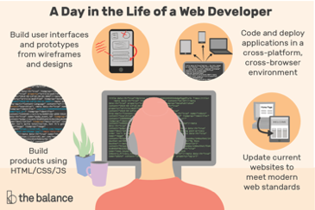
what’s the role of a web developer
The web developer plays several roles. Contrary to what most people think, its role is not limited to the creation and delivery of websites. The web developer has a role both upstream and downstream. The main mission known to him is the creation of websites according to the needs of his clients. Each website will have to be adapted to the wishes of its owner.
The role of the web developer is not to provide the presentation of a website. Its role is rather to manage the technical side to offer a platform that looks like what the customer requested. The customer must therefore come to the developer with all the important information. He must already have an idea of ​​the features to be integrated, the presentation, the display, etc.

